Slide 1
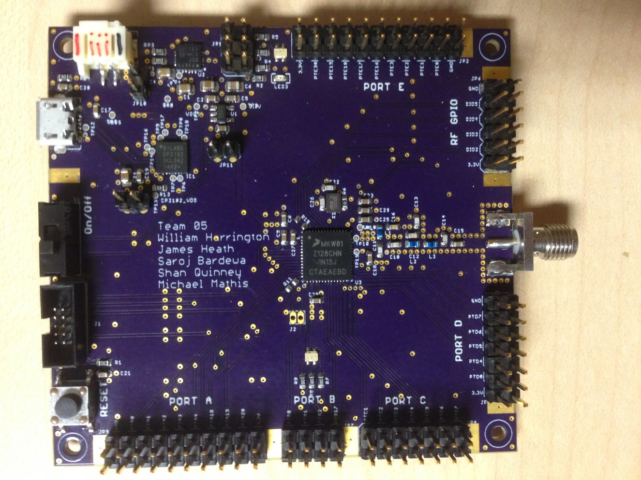

CubeSat C3 Board (Command, Control and Communication)
Team: T05
William Harrington
James Heath
Shan Quinney
Michael Mathis
Saroj Bardewa

Slide 2
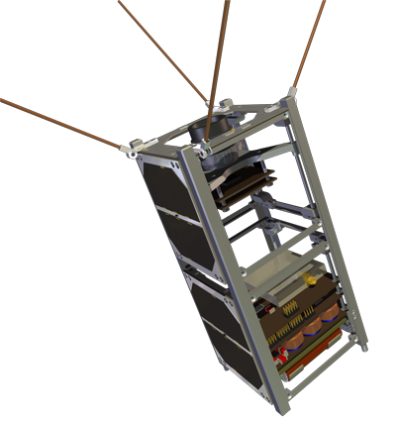
Need
PSAS’s mission is to get a CubeSat into Lower Earth Orbit
Need for a device for command, control and communication (C3) between a CubeSat and a ground station
Board with specific functionalities and broadcast Frequency (436.5 MHz)
Notes:
Problem or Need : What is the problem being solved? Where does it arise?
→ Portland State Aerospace Society has a need of a device that can communication between a CubeSat and a ground Station. The commercial Boards
2

Slide 3
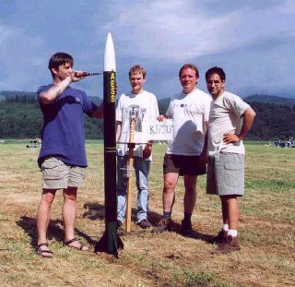
Motivation
Take a small part in PSAS’s CubeSat Mission
Notes:
Motivation: Why is it important? What is the value of a solution?
→Andrew solicited the class to build a system with his specifications
3

Slide 4
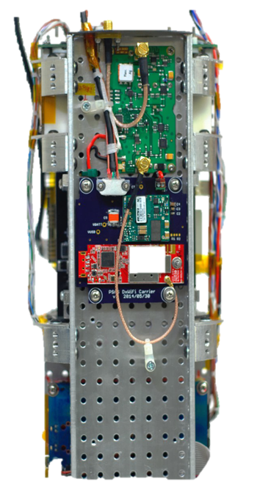
Objective
Build a working prototype to meet the requirements
Notes:
What is the specific objective of this project?A design? Aworking prototype?
4

Slide 5
Requirements
Must:
Be a breakout board
Have a transceiver for RF communications
Have a visible indication of communication
Have an antenna capable of 435-438 MHz frequency band transmission
Able to fit within CubeSat form factor (no bigger than (10cm x 10cm x 10cm)
Have access to UART, I2C,SPI,GPIO and ADCs/DACs

Slide 6
Requirements (Cont.)
Should:
Use USB interfacing
Be able to send/receive data packets via RF communication
Be battery powered
If battery powered, utilize USB for recharging
May:
Be capable of long distance communication
Be capable of sending/receiving data packets
Be capable of operation in space temperature range (-30C to 60C)

Slide 7
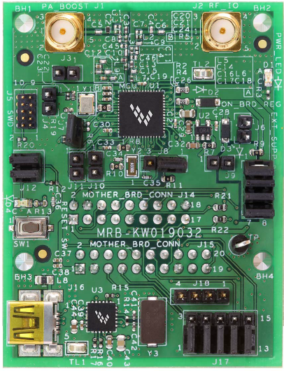
Alternative
Freescale MRB-KW019032NA
Notes:
What other alternatives exists?
→ MRB-KW0x board, but it does not meet the frequency needs and other limitations
7

Slide 8
Approach
The approach was to make a breakout board that was easy to interface and test and capable of RF communication.
User-centered design

Slide 9
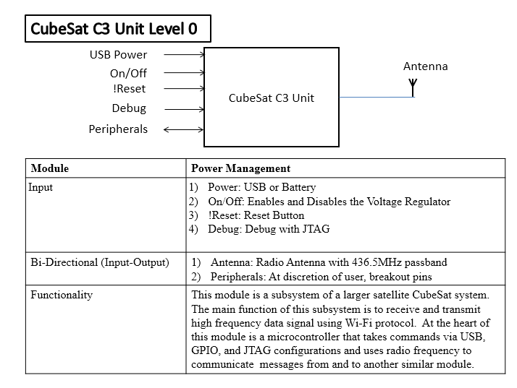
Design - Level 0
Notes:
May need multiple subAheadings here (e.g. H/W and S/W, or multiple subsystems) Describe design using appropriate methods (e.g. UML models, algorithms) Discuss design alternatives, tradeAoffs, decisions made
9

Slide 10
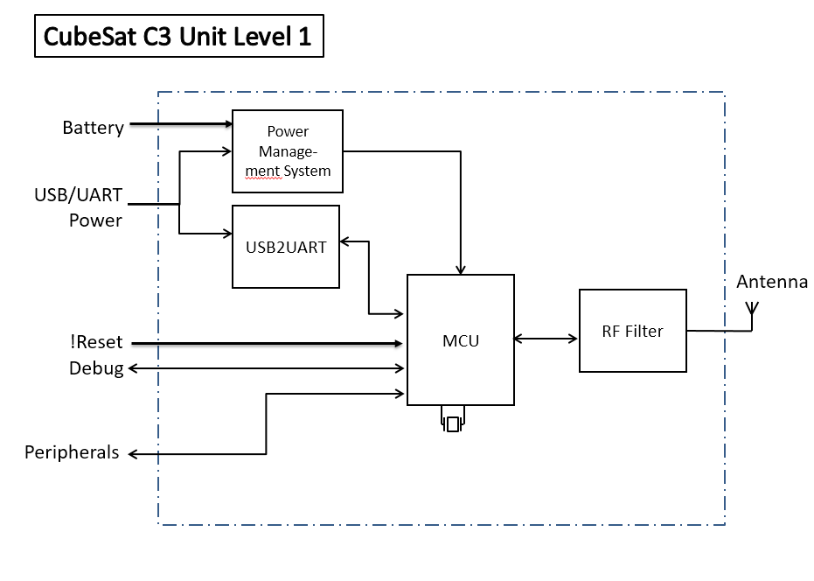
Design - Level 1
Notes:
May need multiple subAheadings here (e.g. H/W and S/W, or multiple subsystems) Describe design using appropriate methods (e.g. UML models, algorithms) Discuss design alternatives, tradeAoffs, decisions made
10

Slide 11
Implementation - Tools
Eagle CAD for PCB layout
OpenOCD for debugging
Multimeter
JTAG connector
Oscilloscope
USB to micro-USB cable
VNA
Board Router
Reflow Oven
Laser Cutter
Notes:
Tools employed (e.g. simulation/modeling tool, PCB layout, IDE, crossAcompilers)
11

Slide 12
Implementation: Code
SPI Configuration
Communication with Transceiver
Functional GPIO
Clock Routing
Toolchain

Slide 13
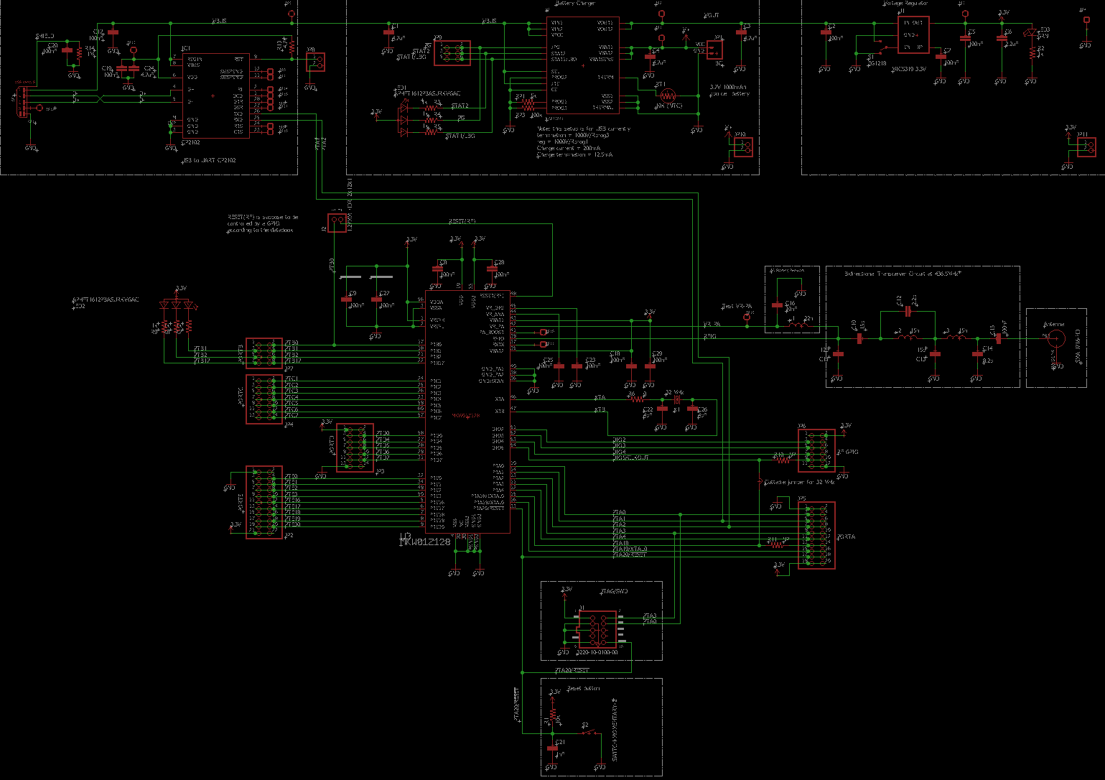
Implementation - Schematics
Notes:
13

Slide 14
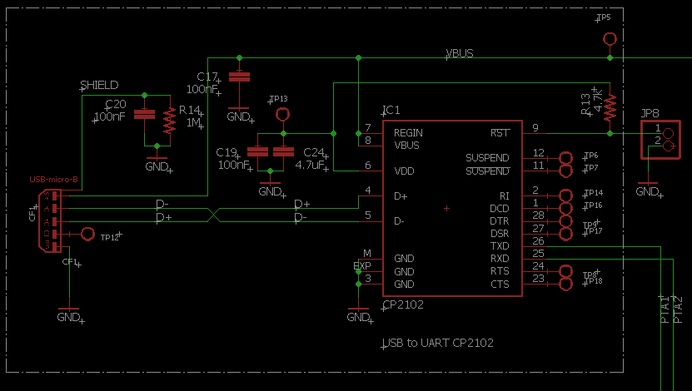
USB to UART

Slide 15
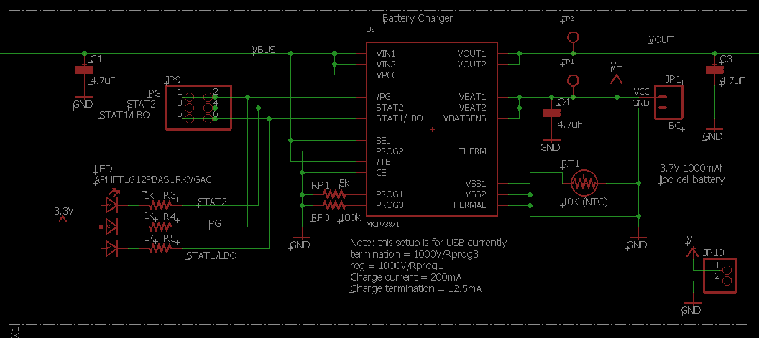
Battery Charger

Slide 16
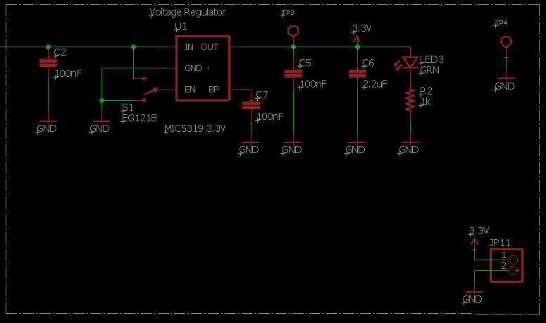
Voltage Regulator

Slide 17
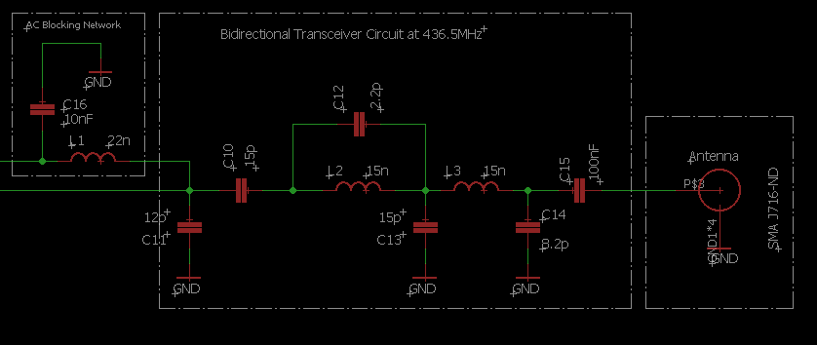
RF Filter

Slide 18
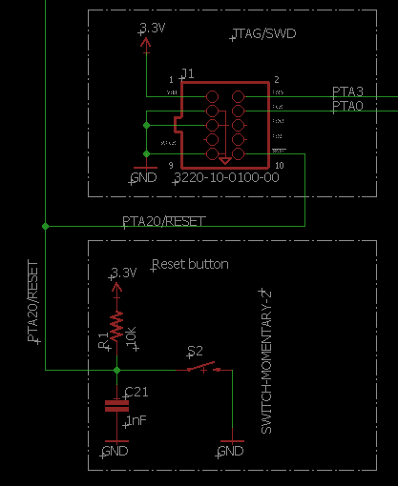
JTAG and Reset

Slide 19
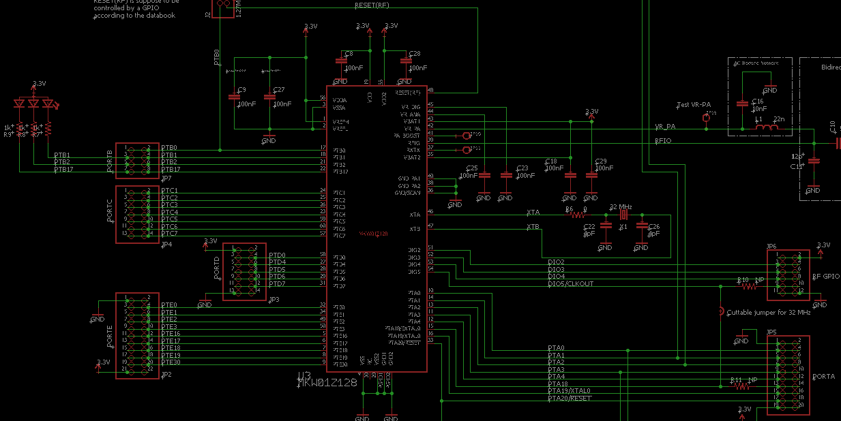
MCU

Slide 20
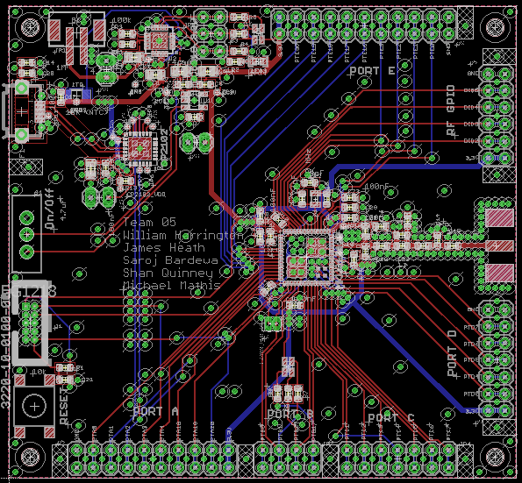
Board Layout
Notes:
20

Slide 21
Finished Board
Notes:
21

Slide 22
IP and Prior Work
Helpful resources:
MKW01Z128 : Highly-integrated, Cost-effective Single-package Solution for Sub 1 GHz Applications
MKW01xxRM: Sub 1 GHz Low Power Transceiver plus Microcontroller Reference Manual
KW01 Development Hardware: Reference Manual
All open source
Notes:
Brief summarize what use you made of prior work or IP including but not limited to ideas, designs, schematics, board layouts, code.
22

Slide 23
Testing
Prodded test points with OSC/MM to check voltage over the board (3.3V, Vbus, clock, etc.)
Rapidly prototyped filter boards and tested with the VNA
Self-checking via LEDs
Notes:
Example of System Testing
23

Slide 24
Testing (Cont.)
Test Matrix goes here
Notes:
Example of Interface Testing
24

Slide 25
RF Results
We were not able to implement the radio due to time restraints on firmware coding
RF Filter worked as tested by the prototype boards
Antenna testing with the protoboards also showed a success on the VNA

Slide 26
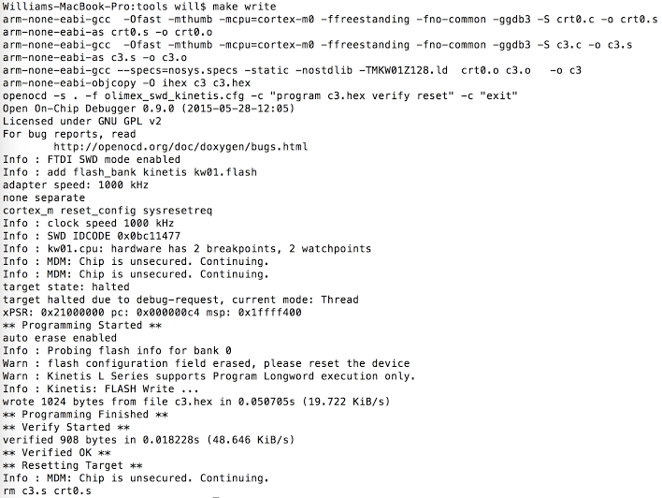
Firmware Results
Notes:
Results What worked? How well? What didn’t? Why?
26

Slide 27
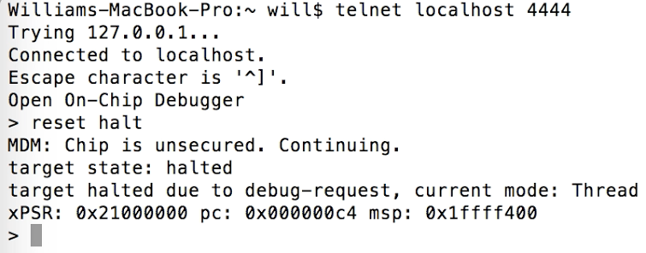
Firmware Results (Cont.)

Slide 28
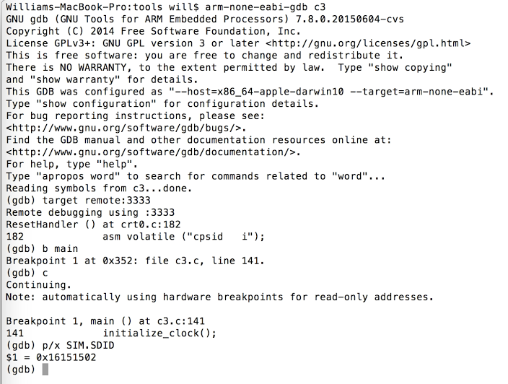
Firmware Results (Cont.)

Slide 29
Contributions
RF (Team Black Magic AF)
Shan
Jake
Firmware (Team Bare Metal AF)
Will
Mike
Video/Documentation
Saroj
Notes:
What were the contributions of each member (e.g. who did PCB, coding, testing, writing)?
29

Slide 30
Lessons Learned
Overly Ambitious
Weren’t prepared for difficulty
Start Programming Earlier
Team Accountability

Slide 31

Acknowledgments
Portland State University
Aerospace Society (PSAS)
Theo Hill of PSAS
Devin ECE411 TA
Notes:
31

